Slide 1
InstaWeight
Weight estimation of Cattle through computer vision.
Team Members:
Atif Mehmood
Sayyada Sahar Fatima
Mohammad Ateeb Ahmed

Slide 2
Overview of the System
The autonomous weight estimating system has two active actors a system with three
components. A normal user/ farmer can capture the image of a cattle to measure the
weight of an animal. The mobile application and web application will be connected
to core component. The owner of the farm or a rancher can access the admin panel
to keep track of the growth of the cattle.

Slide 3
Functional Requirements
Business Requirements
1. The system should be 90% to 95% accurate

Slide 4
Functional Requirements
Mobile Application:
The mobile application must have the following features and functionalities:
1. Application must have login functionality to use the application. It will be not
be accessible to unauthenticated users.
2. The image of cattle should be captured by the application.
3. An identification number would be attached with the image when send to
server. Because there is no other way of identifying cattle.

Slide 5
Functional Requirements
Dashboard:
(a) The admin panel would display the overall growth of all cattle in last six
months through pi-chart.
(b) It would show the growth progress of each cattle on individual level in
last six months.
(c) Admin panel would have different tabs and button to add, update and
delete.
(d) Record of the animal can be update by clicking on the “Update Record”
tab.
(e) The cattle’s record can be deleted by “Delete” button.

Slide 6
Functional Requirements
Cattle Management:
Add Cattle
i. To add an animal into the system, it would be required to add some details such as age, gender, type etc. into the system.
List View
i. List of all animals would be displayed.
(c) View Details
i. On clicking view details, the complete details of every individual animal would be displayed on screen.

Slide 7
Functional Requirements
Settings:
(a) Personal configuration section from where admin can change personal info

Slide 8
Non-Functional Requirements
Following are the non-functional requirements of our system.
Security:
The user’s data that would be required during sign up should be confidential, safe and secure.
Performance:
The system should not take less than 3 minutes to process the image and estimate weight.
Compatible:
The system should be compatible with all android devices.
Memory Efficient:
The mobile application should be space efficient and should not occupy large space of memory.
Usability:
The interface of the system should be simple and flow of app should be understandable by farmer who is not well educated.

Slide 9
Non-Functional Requirements
6. Scalability:
The system should be scalable so that it can later be used in real world or at
industry level.
7. Maintainability:
The system should be easily maintainable so that it can become more advance and efficient when use in industry.
8. Legal:
According to the intellectual property rights, the system should only be used by Folio3

Slide 10
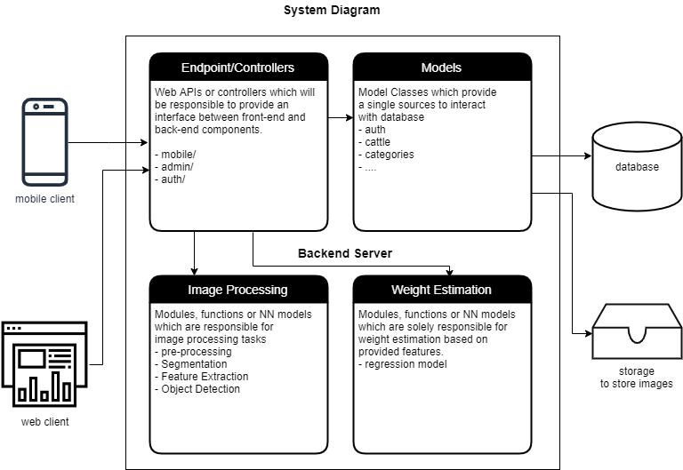
System Diagrams

Slide 11
System Components
Database
This component will be responsible of storing data into relational format. This will
be only accessible by Models (in MVC) component in the back-end.
Tools and Technologies:
PostgreSQL, SQL

Slide 12
System Components
Back-end Server
This component will have further subcomponents:
1.Models:
This component is responsible to defining the schema of the database and interact with the database. This is the only module which interacts with the database so that there is one source of truth for insertion and retrieval of data.
2. Image Processing module:
This component will have methods responsible for segmentation, object detection and features extraction.
3. Weight Estimation:
Modules, functions or NN models which are solely responsible for weight estimation based on provided features.
i.e. regression model

Slide 13
System Components
4. Endpoints / controllers:
These Endpoints will define communication routes between server and clients and will bridge between the frontend and backend components.
Collectively we refer to Image Processing and Weight Estimation as Core
Tools/Technologies:
OpenCV, Django 2, MXnet

Slide 14
System Components
Mobile Client:
This component will be assisting the user in taking pictures of the cattle and sending it to the server.
Tools/Technologies:
React Native
Webclient
This component will be helping in managing the information of animal and keeping tack of their weights on the go.
Technologies:
Html, CSS, JavaScript

Slide 15
Q & A

